Slide 1
Energy Classifications
Introduction:

Slide 2
Energy Classifications
Primary and Secondary energy:

Slide 3
Energy Classifications
Major Primary and Secondary energy sources:

Slide 4
Energy Classifications

Slide 5
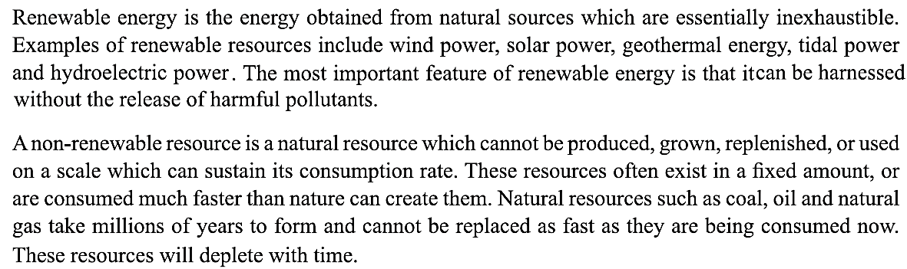
Energy Classifications
Renewable and Non-renewable energy

Slide 6
Energy Classifications
Renewable and Non-renewable energy

Slide 7
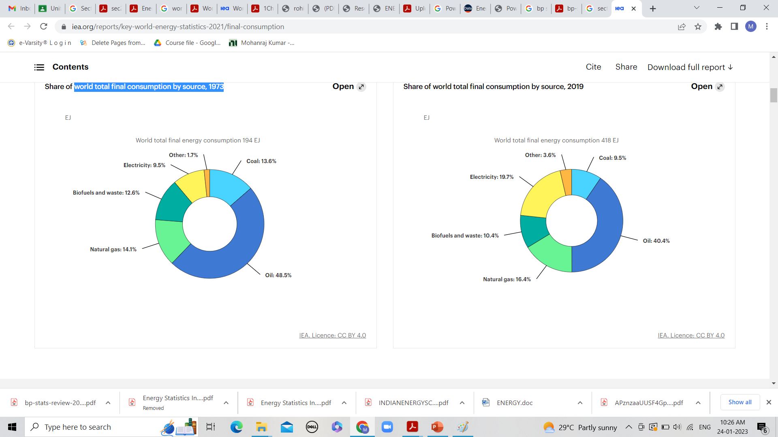
Sectorial Energy consumption:
World total final consumption by source – 1973
Exajoule (EJ): 1 EJ = 10¹⁸ J

Slide 8
Sectorial Energy consumption:
World total final consumption by source - 2019

Slide 9
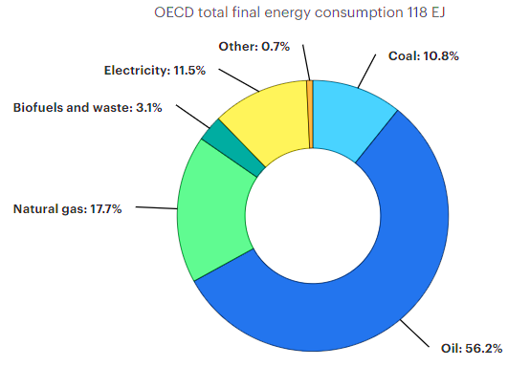
Sectorial Energy consumption:
OECD total final consumption by source – 1973
OECD - Organization for Economic Cooperation and Development (OECD)

Slide 10
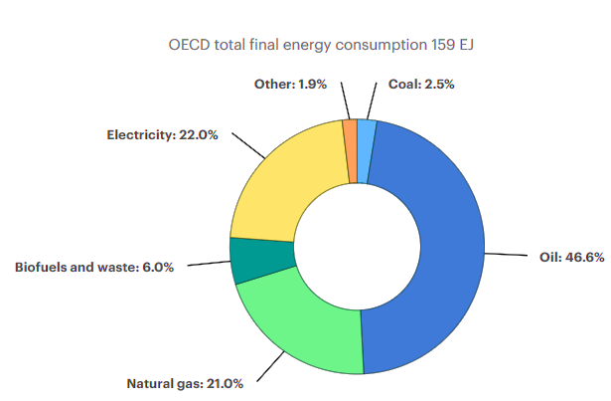
Sectorial Energy consumption:
OECD total final consumption by source - 2019

Slide 11
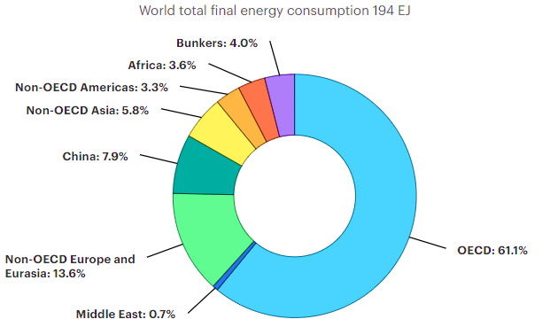
Sectorial Energy consumption:
World total final consumption by region - 1973

Slide 12
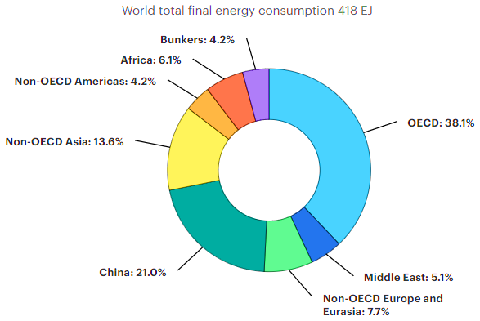
Sectorial Energy consumption:
World total final consumption by region - 2019

Slide 13
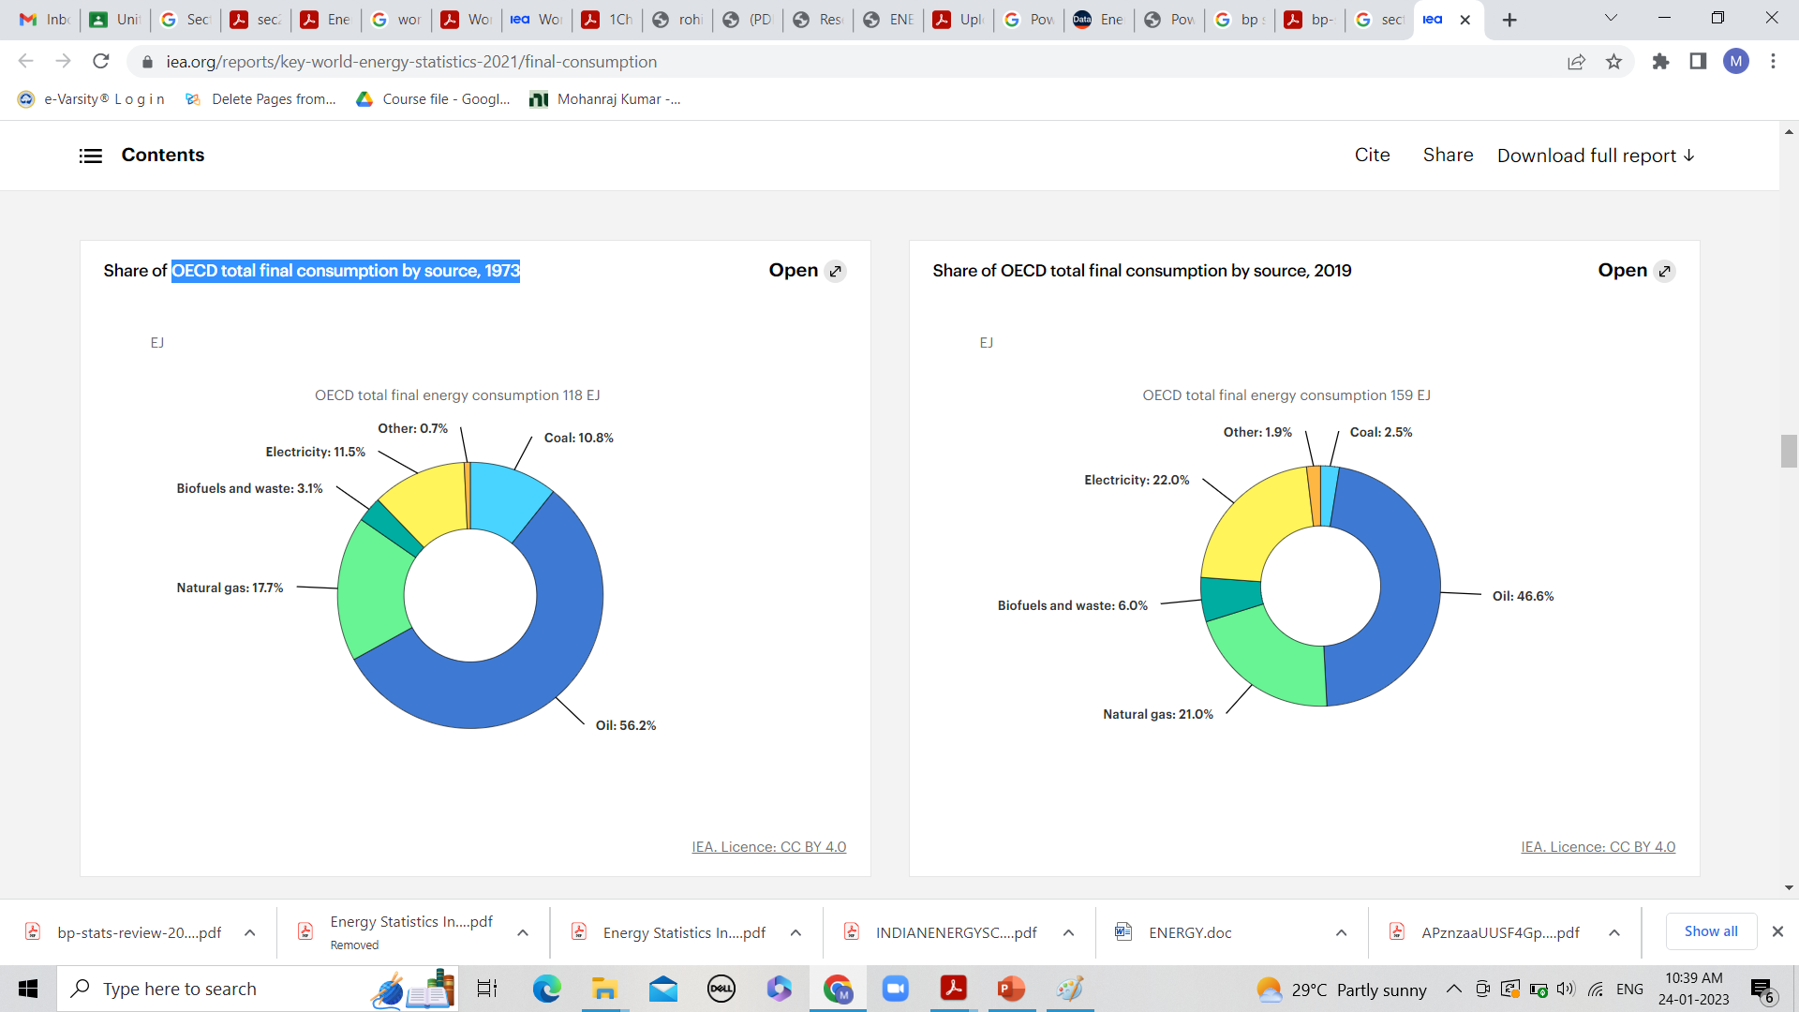
Sectorial Energy consumption:
OECD total final consumption by source - 1973

Slide 14
Sectorial Energy consumption:
OECD total final consumption by source - 2019

Slide 15
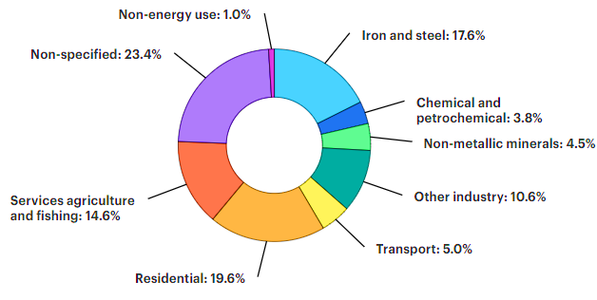
Sectorial Energy consumption:
Coal final consumption by sector - 1973

Slide 16
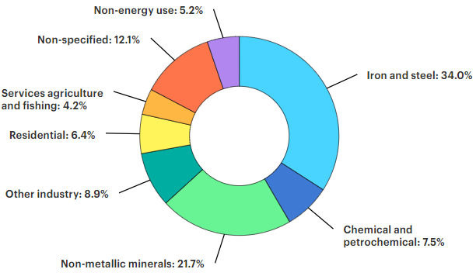
Sectorial Energy consumption:
Coal final consumption by sector - 2019

Slide 17
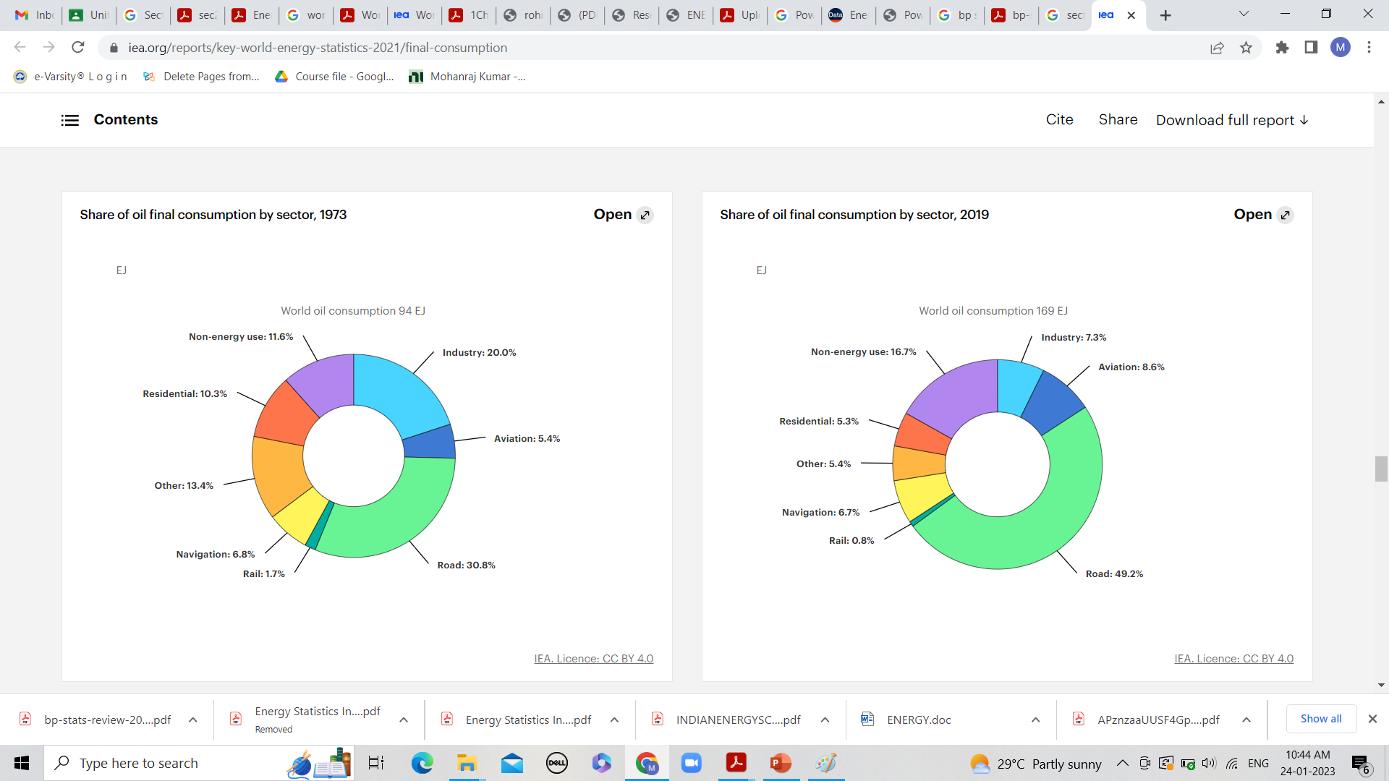
Sectorial Energy consumption:
Oil final consumption by sector - 1973

Slide 18
Sectorial Energy consumption:
Oil final consumption by sector - 2019

Slide 19
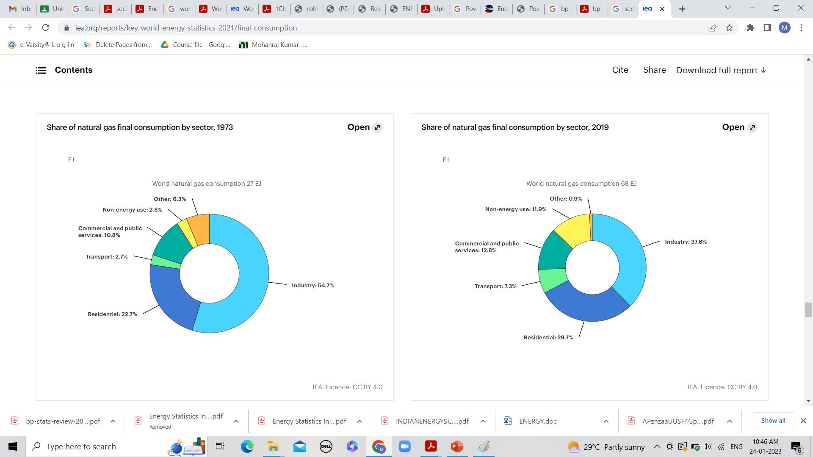
Sectorial Energy consumption:
Natural gas final consumption by sector - 1973

Slide 20
Sectorial Energy consumption:
Natural gas final consumption by sector - 2019

Slide 21
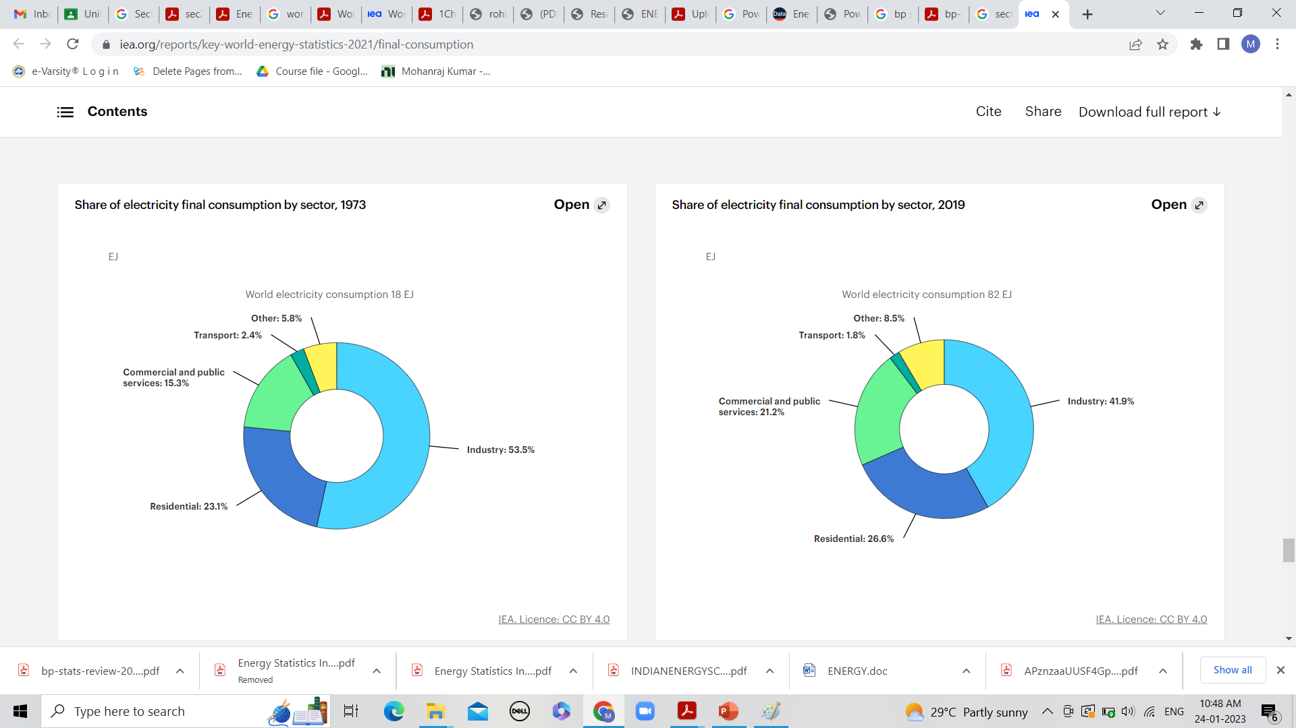
Sectorial Energy consumption:
Electricity final consumption by sector - 1973

Slide 22
Sectorial Energy consumption:
Electricity final consumption by sector - 2019

